Slide 1
How to use RCOUNT to add a running number to each row of a report in Alma Analytics
Yoel Kortick | Sept. 2024

Slide 2
Introduction
How is it done?
Let's check the results

Slide 3
Introduction

Slide 4
Introduction
It may be desired to number each row of a report in an Alma analytics report which contains a table.
Here we are refering to a running number which has no connection to the number of the row if the table were exported to Excel.
As we will see, this is the row number of the report in Alma Analytics

Slide 5
How is it done?

Slide 6
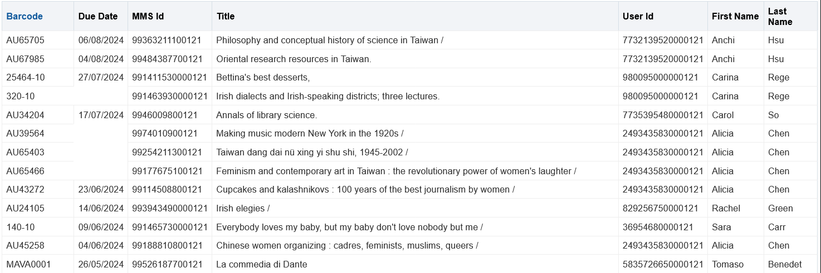
How is it done?
We have a report of overdue items (active loans with due date earlier than today).
We want to add another column to this report with the row number

Slide 7
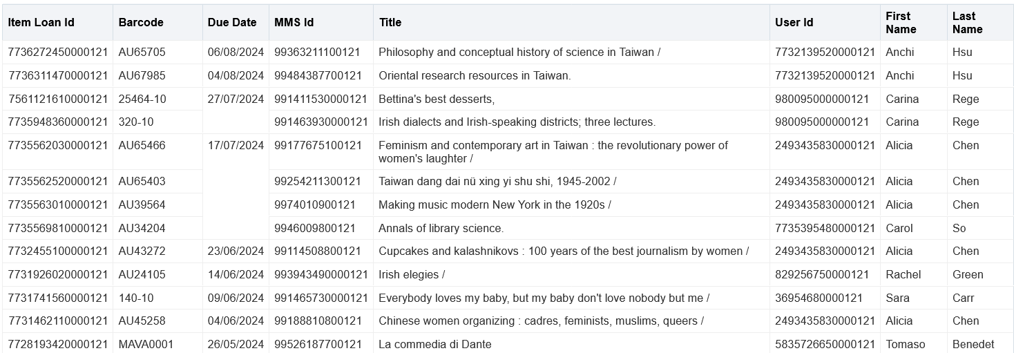
How is it done?
Add any column to the table. It does not matter what column because later we will change it. Here we add "Loan Details"."Item Loan Id“.

Slide 8
How is it done?
In the “Criteria” tab do “Edit formula” on the column which was added and change the formula to RCOUNT(1) as follows
Change the column heading to whatever you want by filling in in desired name in the “Column Heading” field and checking box “Custom Headings”

Slide 9
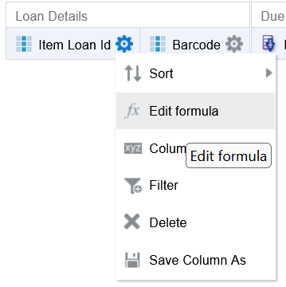
How is it done?
In the “Criteria” tab do “Edit formula”

Slide 10
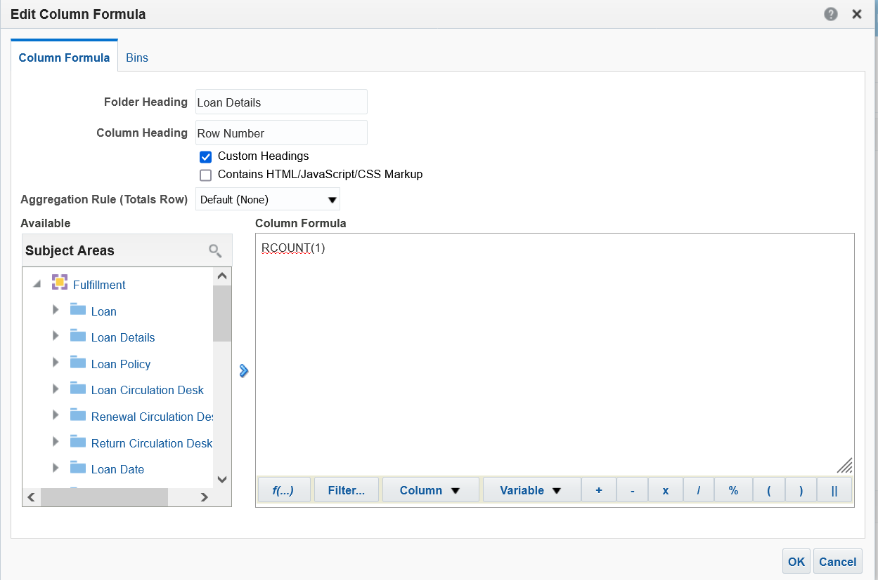
How is it done?
Change the column heading and change the formula to RCOUNT(1)

Slide 11
Let's check the results

Slide 12
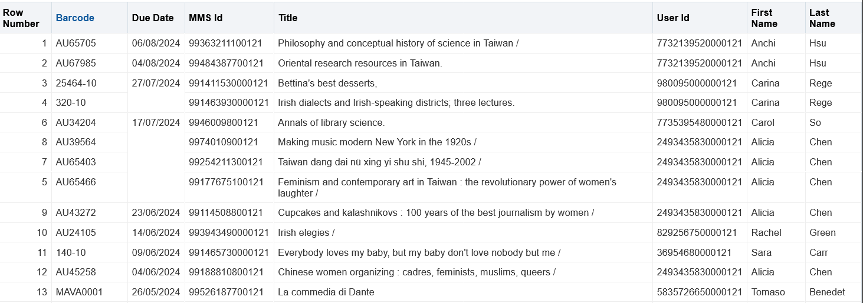
Let's check the results
Now switch back to the “Results” tab and see that you have the row number.

Slide 13
Thank You.
Yoel Kortick

